Slide 1
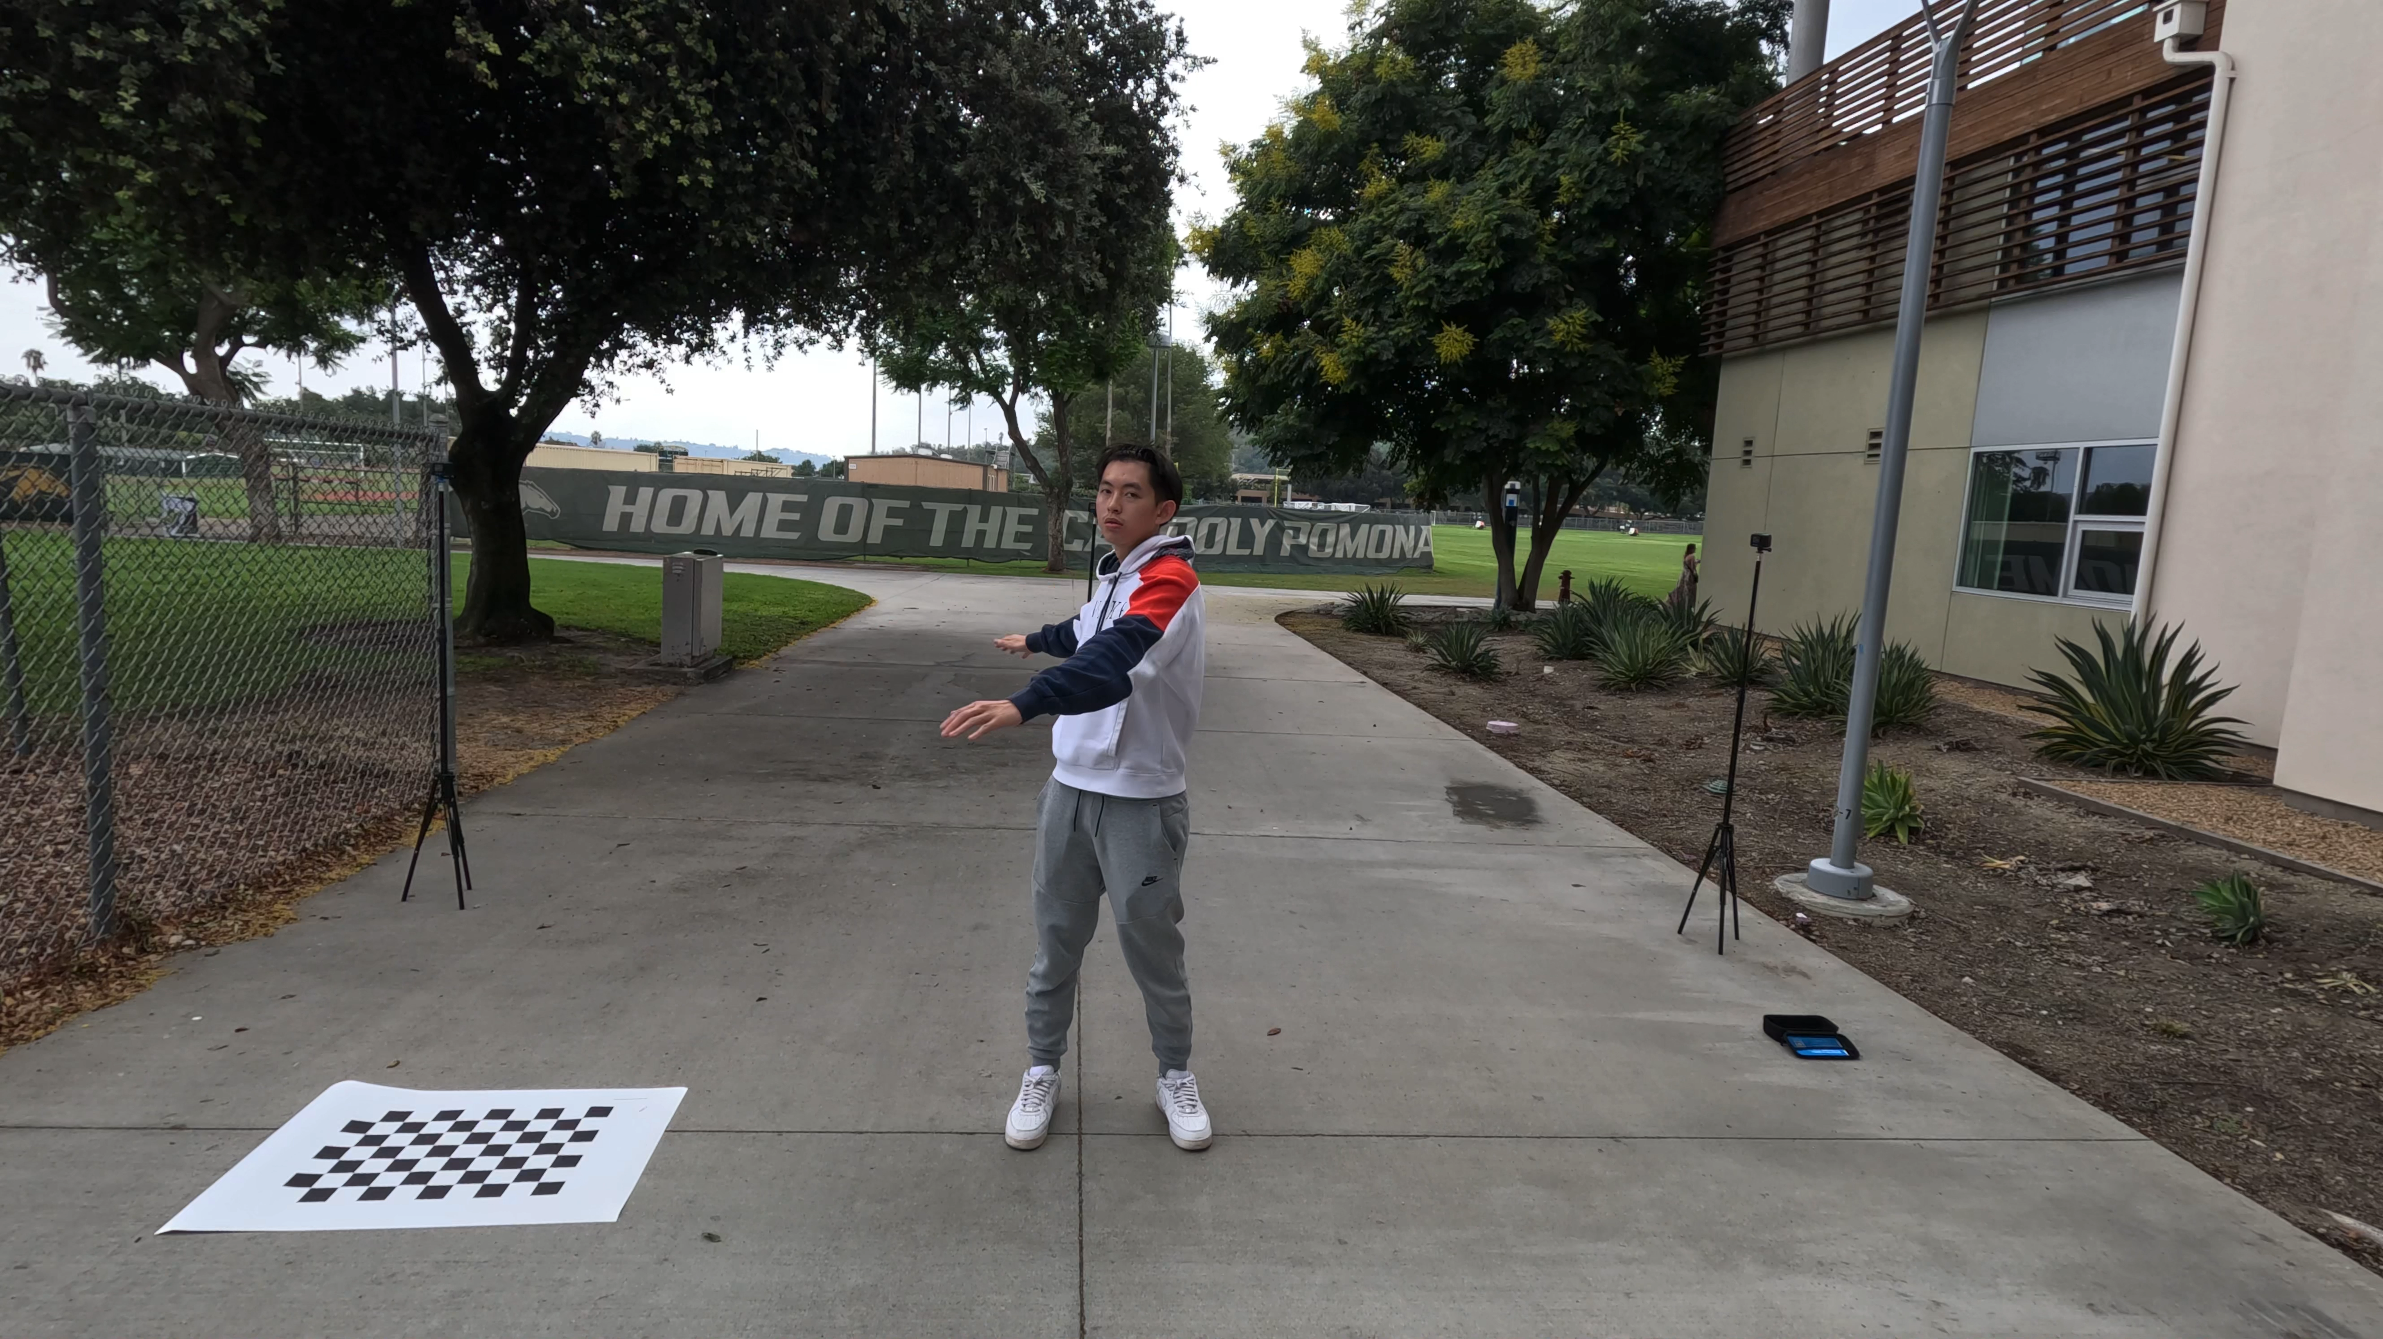

Slide 2
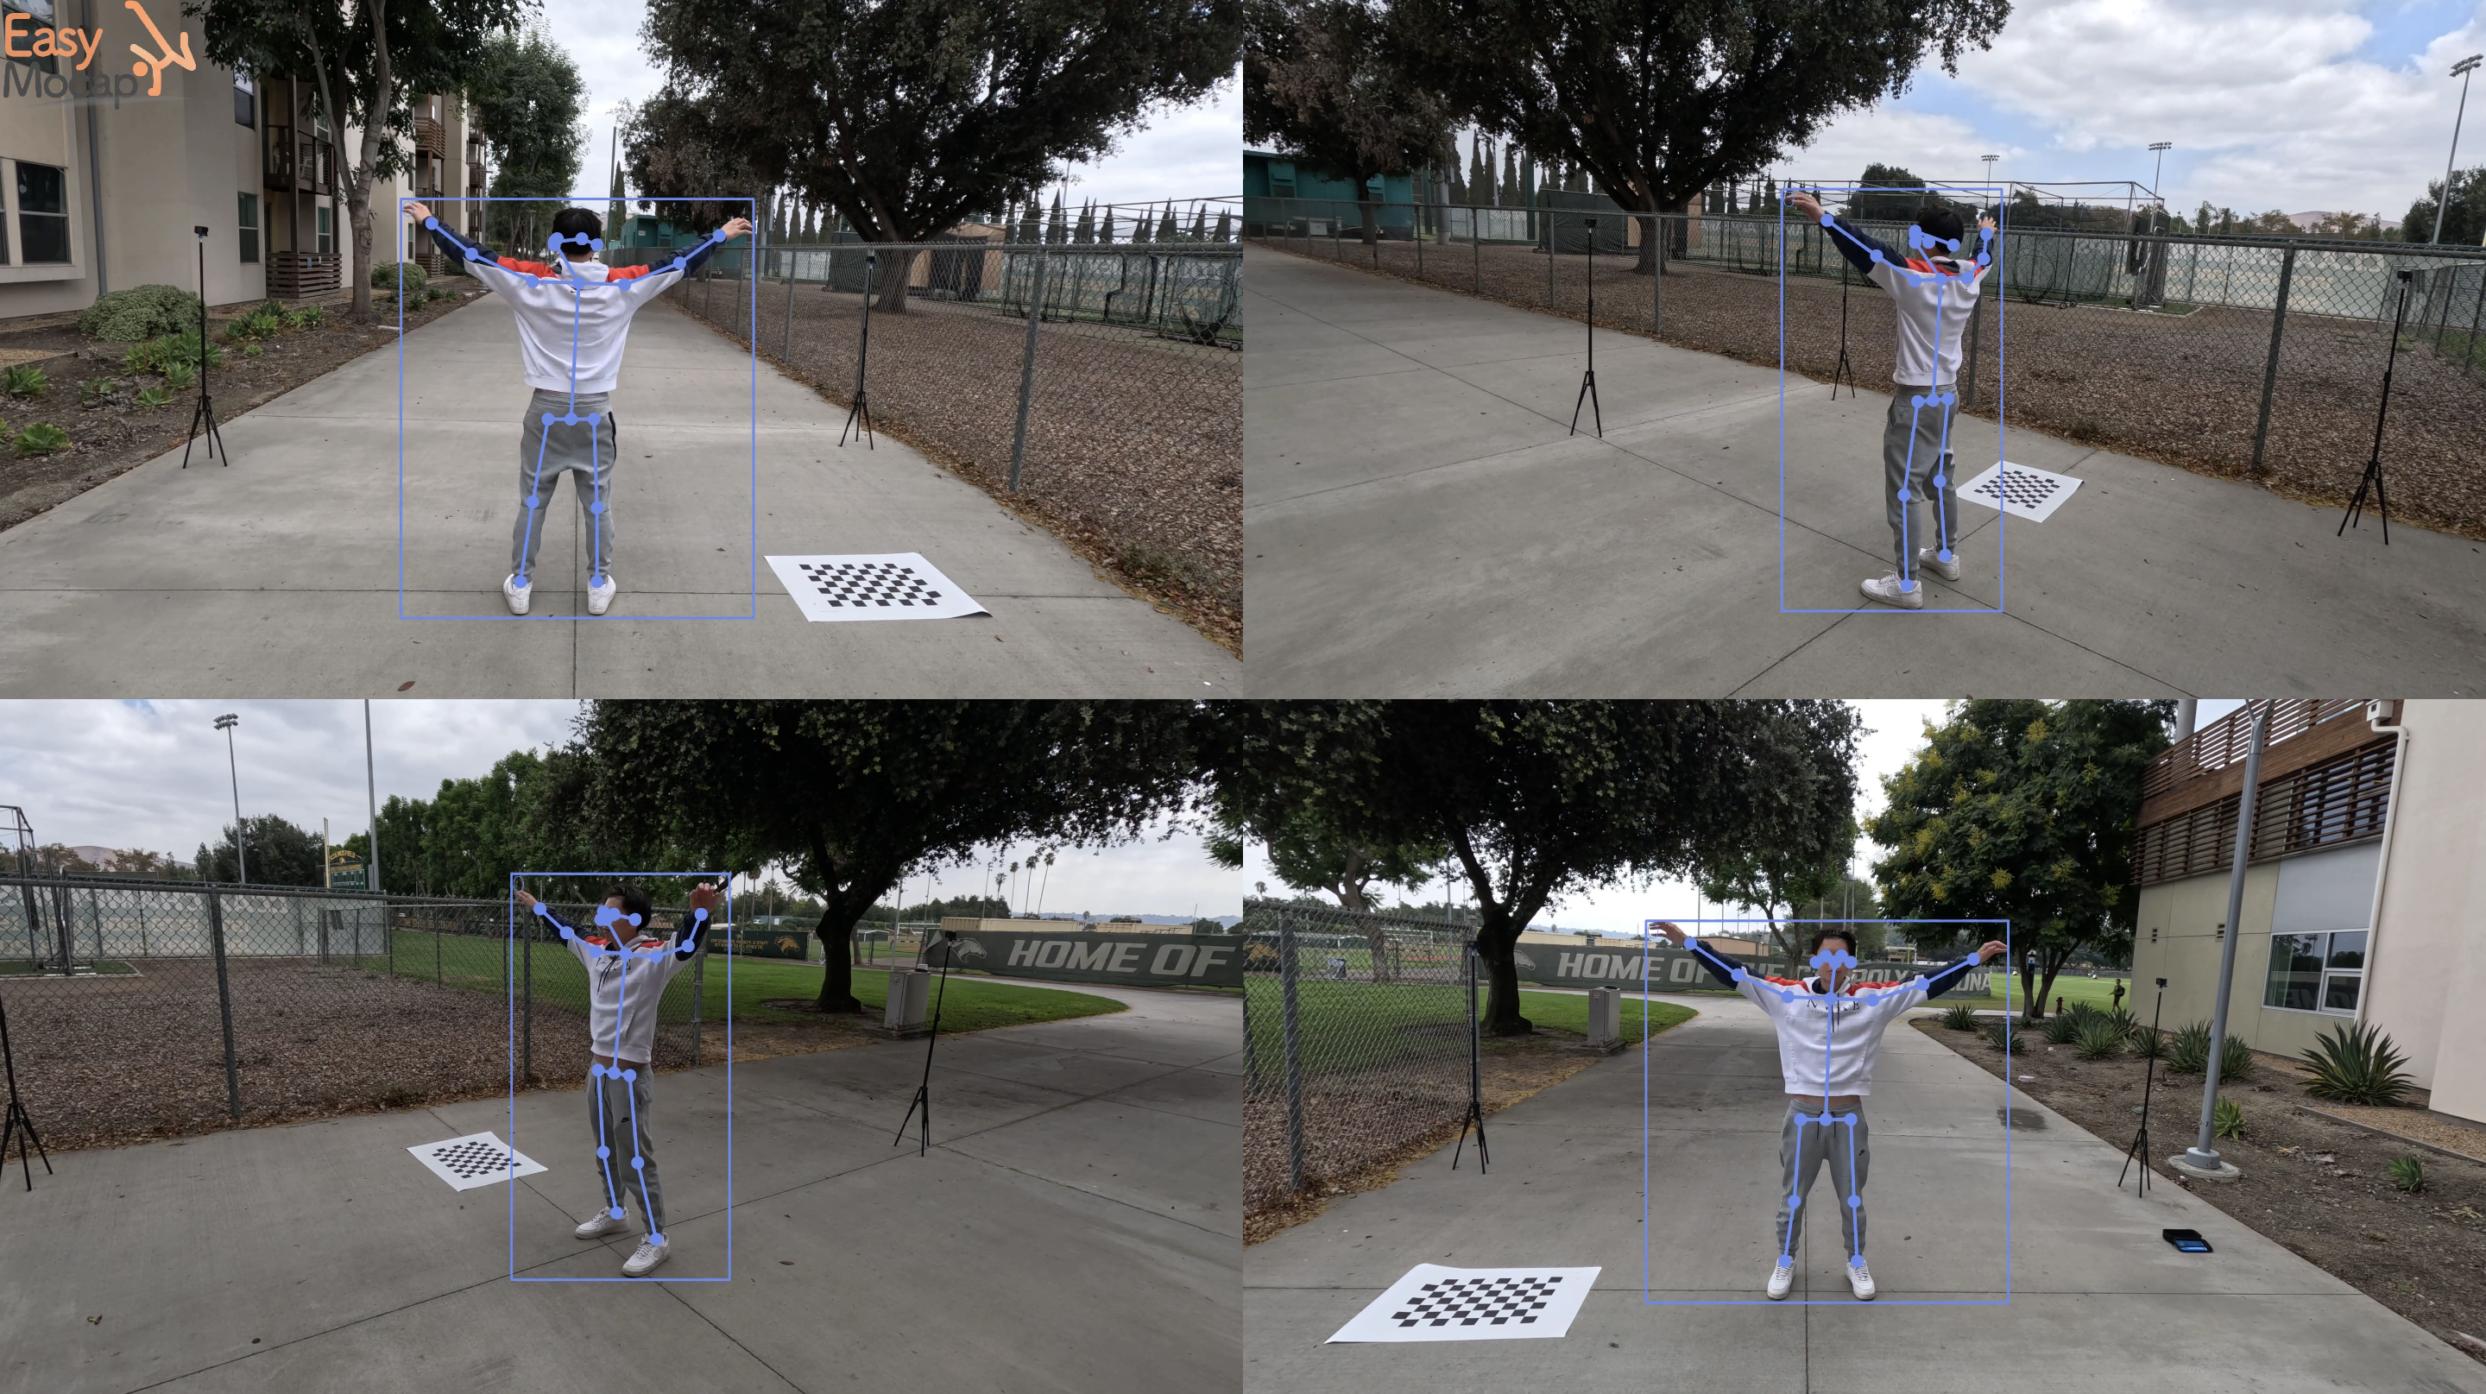

Slide 3
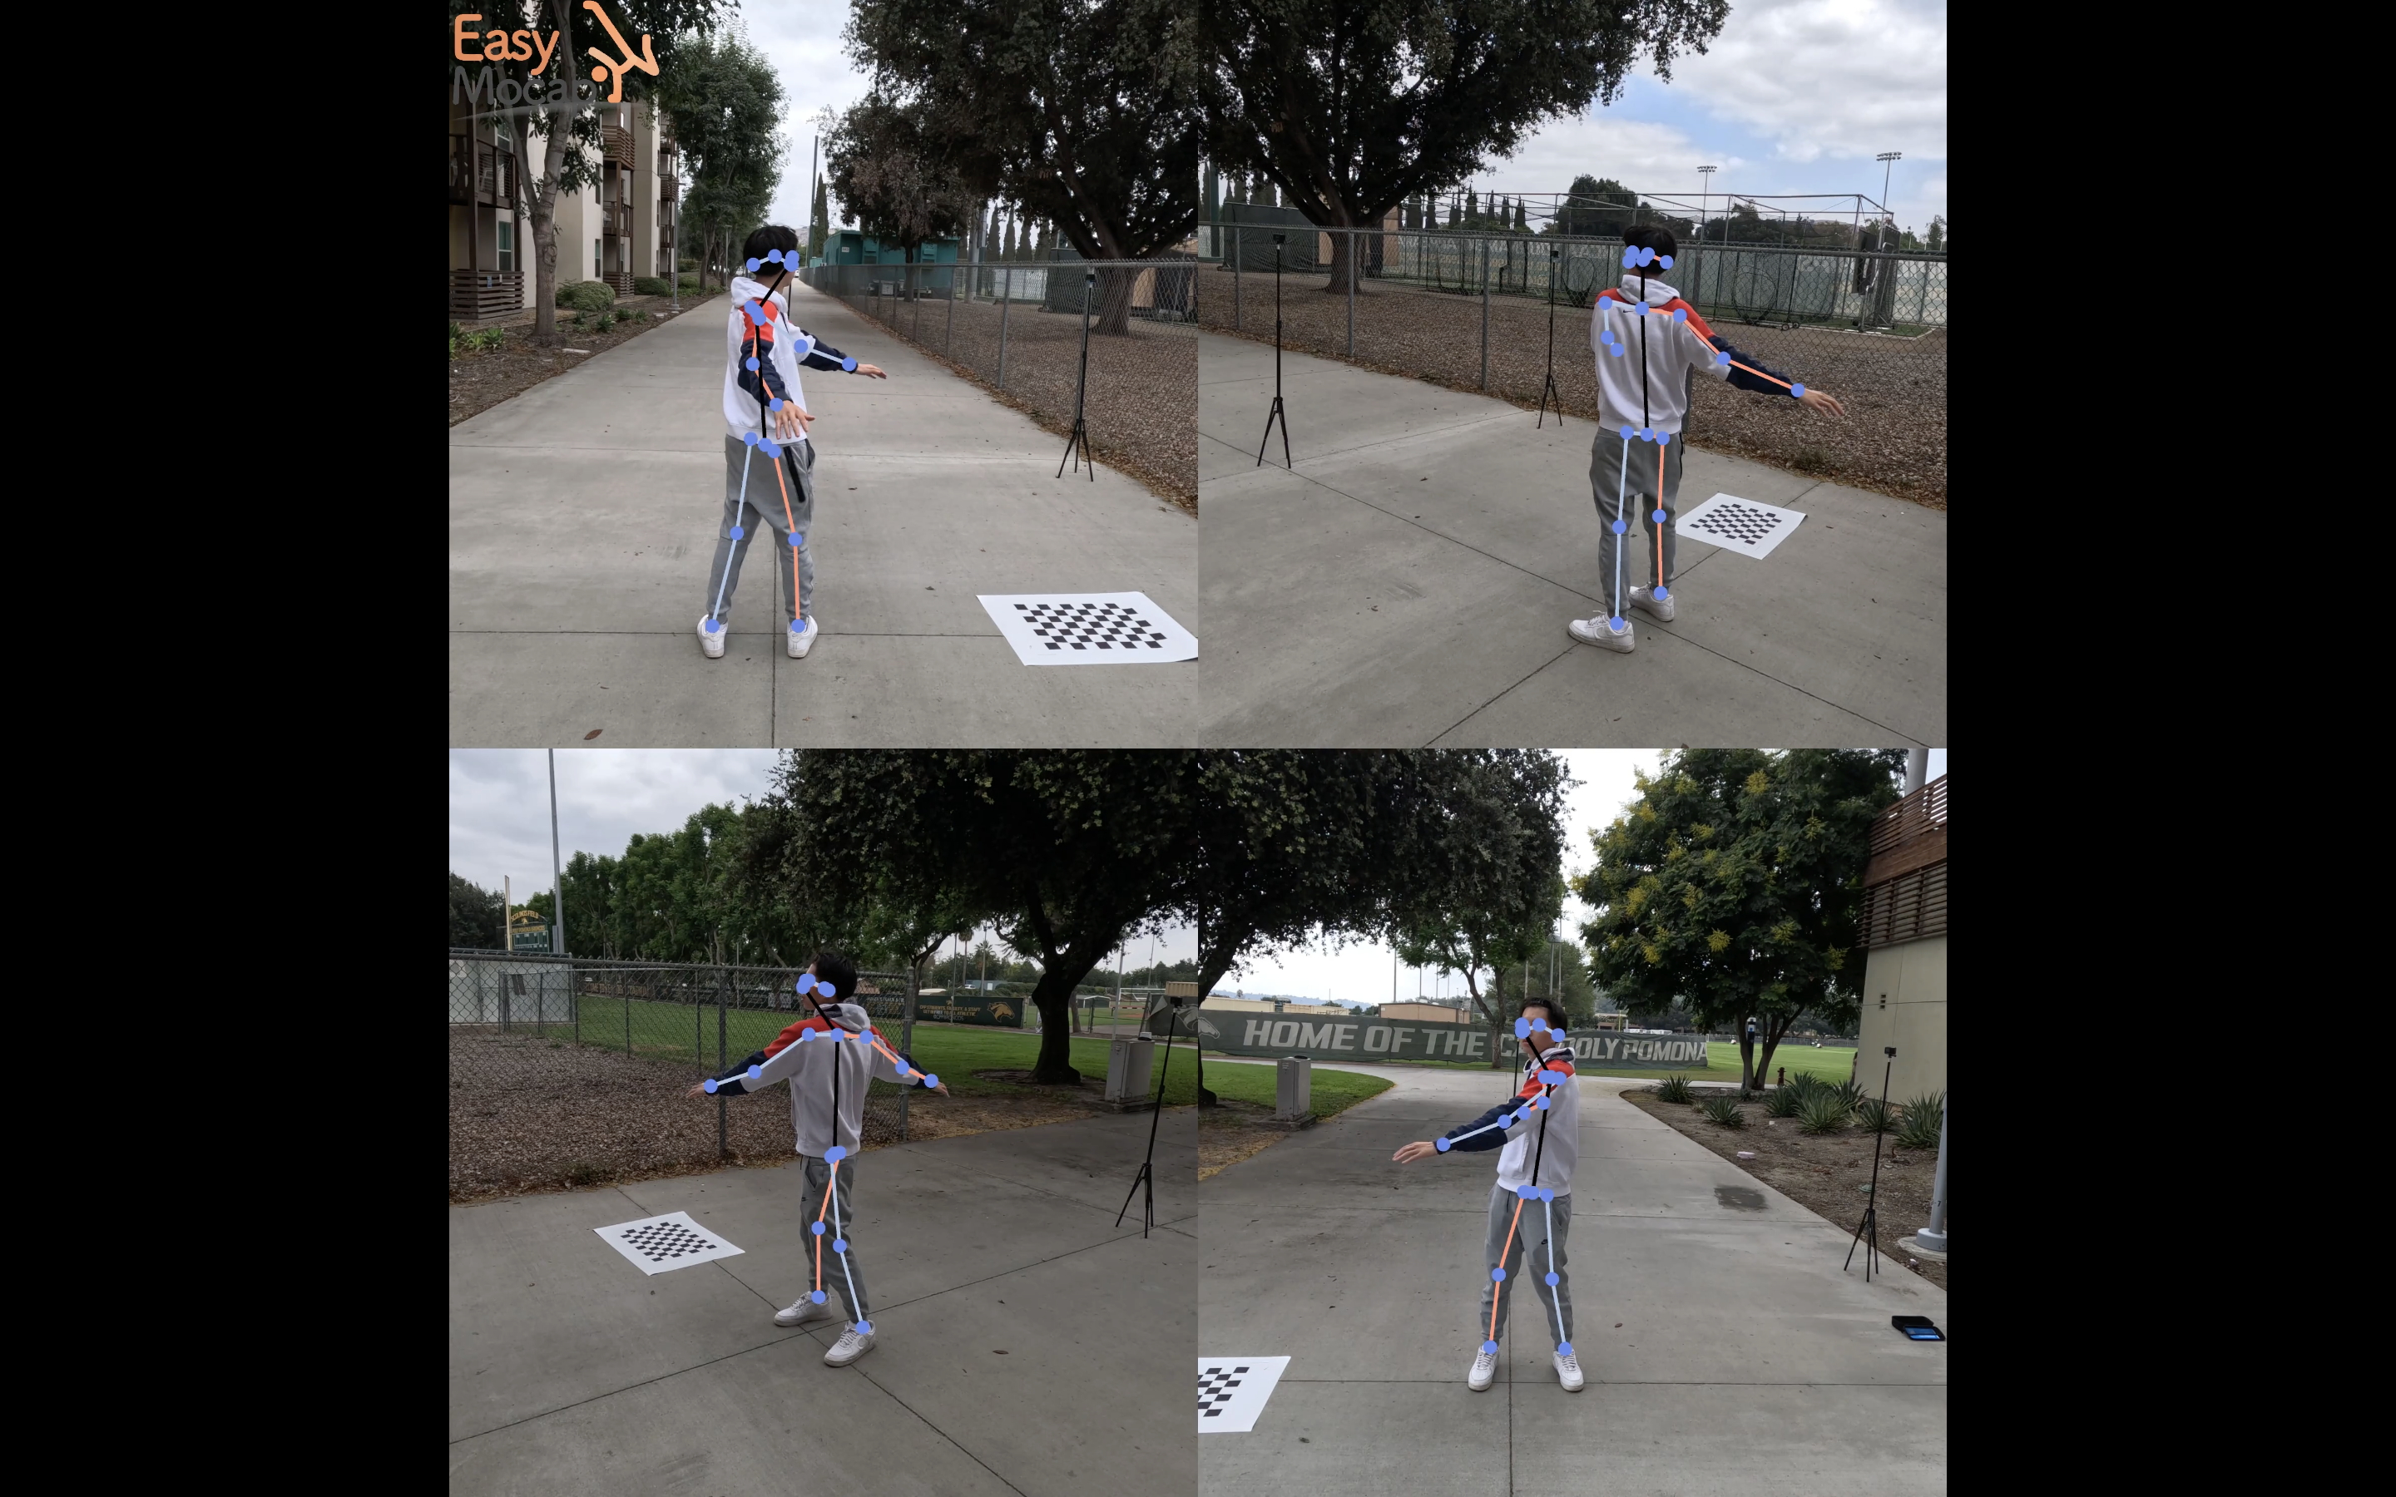

Slide 4
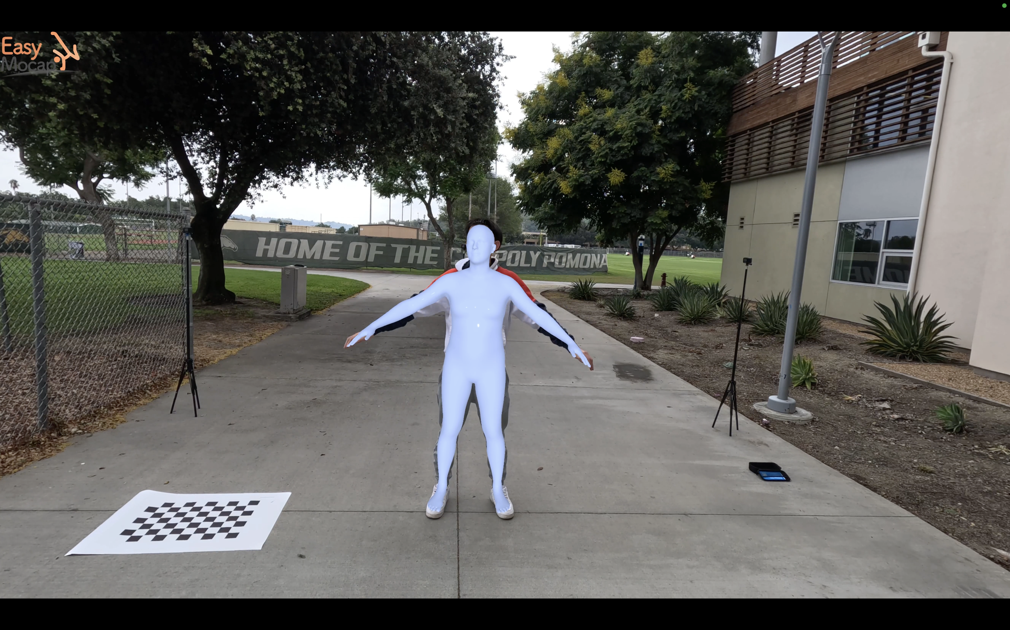

Slide 5
Limitations
Relies on clap detection
Requires a visible checkerboard to determine external camera parameters
Requires multiple angles to capture and reconstruct human motion

Slide 6
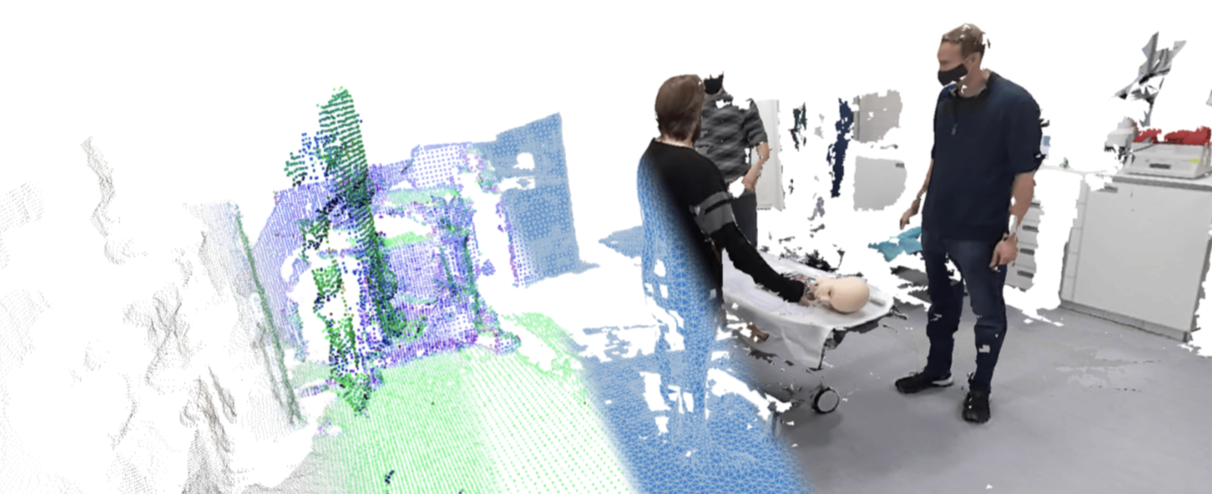
Goal
Extend the applicability of this project to more diverse, real-world scenarios where users can input any images or videos and obtain a 3D mesh that accurately reconstructs their motion.

Slide 7
3 Areas of Work
Develop a method for synchronizing videos that does not depend on clap detection
Implement self-calibration or structure-from-motion (SfM) techniques, allowing external camera parameters to be estimated based on multiple views of a scene rather than relying on known patterns like a checkerboard
Create a deep learning algorithm capable of accurately estimating and reconstructing human motion from a single camera view

